Slide 1
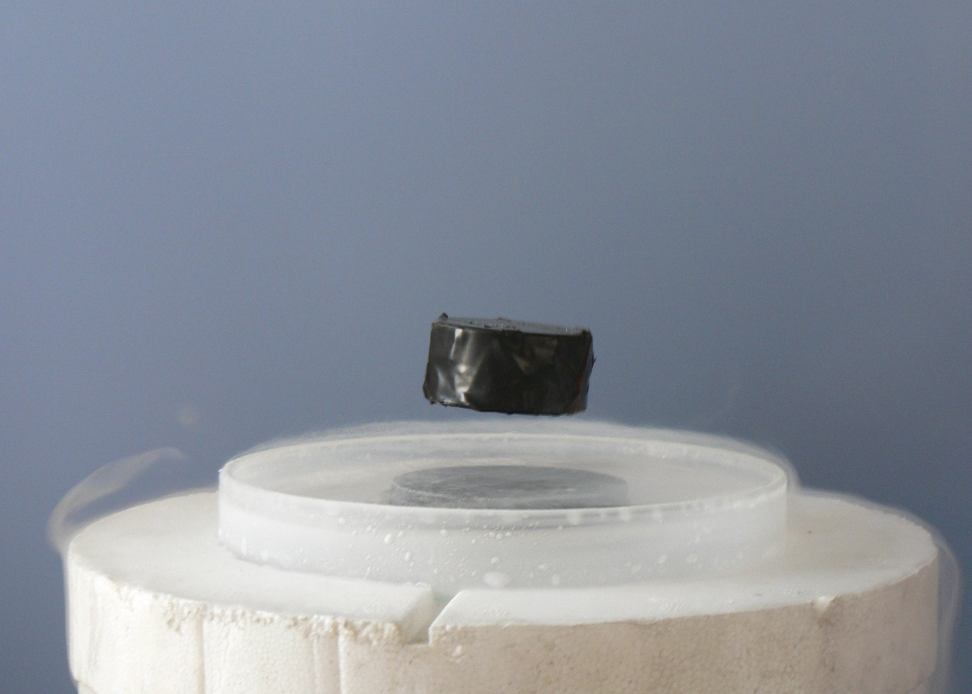
Superconductivity
By: Yakovitskiy Stanislav
IC5-45B
Levitation of a magnet above a high temperature superconductor illustrating the Meissner Effect.

Slide 2
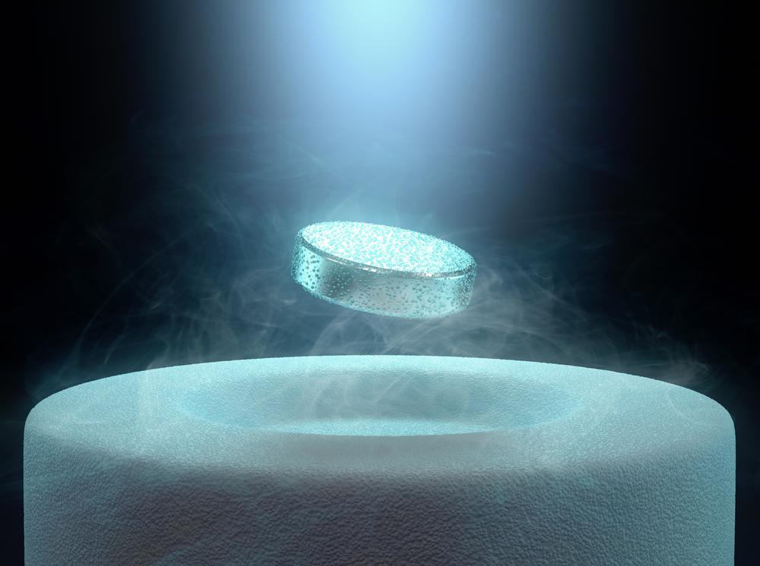
Essential of superconductivity

Slide 3
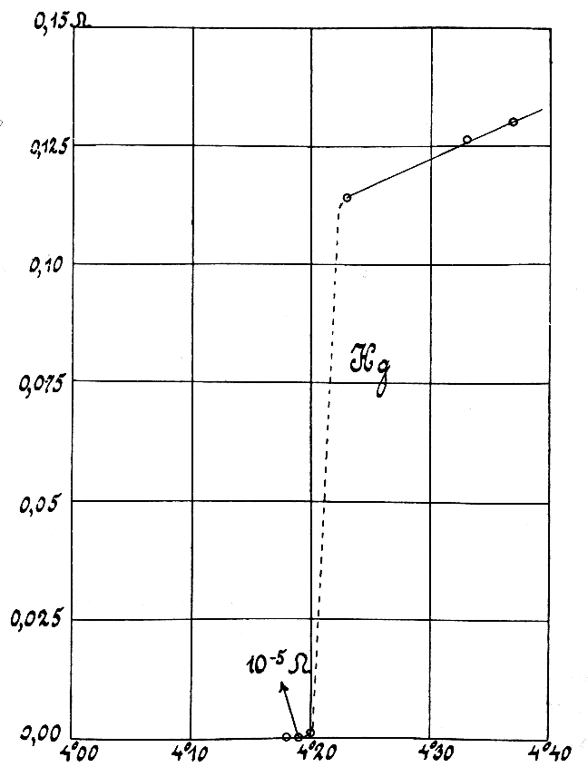
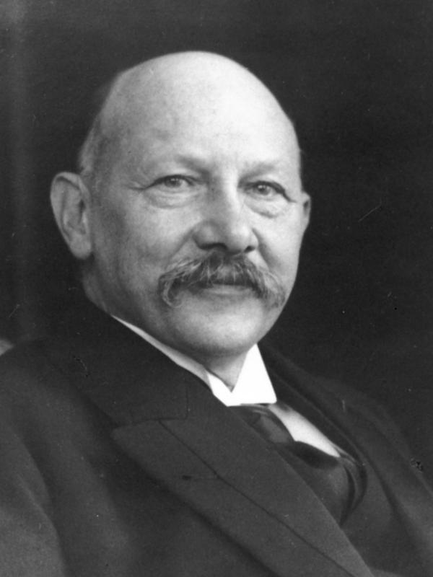
Discovery of Superconductivity
Heike Kamerlingh Onnes

Slide 4
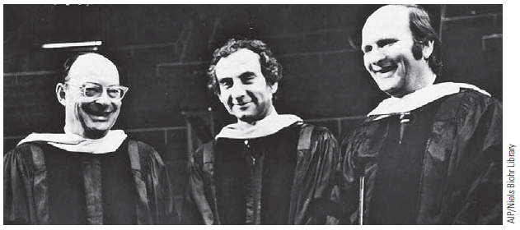
BCS Theory
Left to right: John Bardeen, Leon Cooper, J. Robert Schrieffer

Slide 5
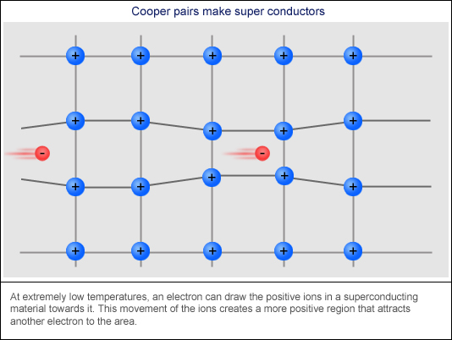
Cooper Pairs

Slide 6
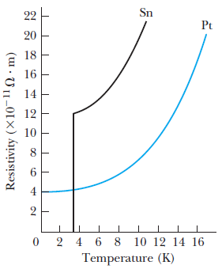
Critical Temperature
Resistivity of superconducting tin and platinum

Slide 7
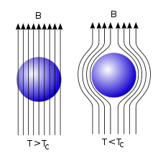
Meissner Effect

Slide 8
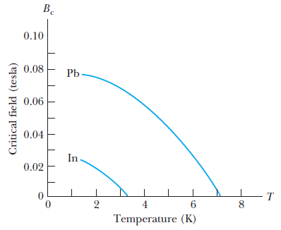
Critical Field
Critical field examples of indium and lead

Slide 9
Future Contributions
Integrated circuits in computers
Magnetic Levitation of Trains (Maglev)
Electrical generators and motors
Superconducting transmission lines
Scientific research

Slide 10
Thank you for your attention!

